Slide 1


Airline Performance Intelligence
(Analysis of 5.8 Million U.S. Flights 2015 Data)
Presented by: Mohammad Faiz | October 2025
Batch : 15th September 2025

Slide 2
CONTENTS
1. Project Overview & Methodology
2. Overall Performance Snapshot
3. Insight 1 – The Control Problem
4. Deep Dive – American Airlines Case Study
5. Recommendation 1 – The Carrier Fix
6. Insight 2 – Infrastructure Bottleneck
7. Recommendation 2 – The Airport Fix
8. Conclusion & Strategic Outlook

Slide 3

1. Project Overview & Methodology
Objective
To reduce system-wide delays and improve On-Time Performance (OTP)
across U.S. airlines by identifying operational bottlenecks,
analyzing delay patterns, and delivering data-driven recommendations.
This project aims to empower stakeholders — including airline carriers,
airport authorities, and regulators — with actionable insights
derived from 5.8 million flight records, enabling smarter scheduling,
better resource allocation, and enhanced passenger experience.

Slide 4




Methodology Summary
🧹Phase 1 & 2
📊Phase 3 & 4
Cleaned and integrated 5.8M flight records into a unified analytical view
Defined KPIs (OTP Rate, Delay Severity) and built a multi-page dashboard in Power BI.
🧠Phase 5
📁Phase 6
Generated insights and recommendations based on delay patterns.
Structured findings into a report and presentation.

Slide 5
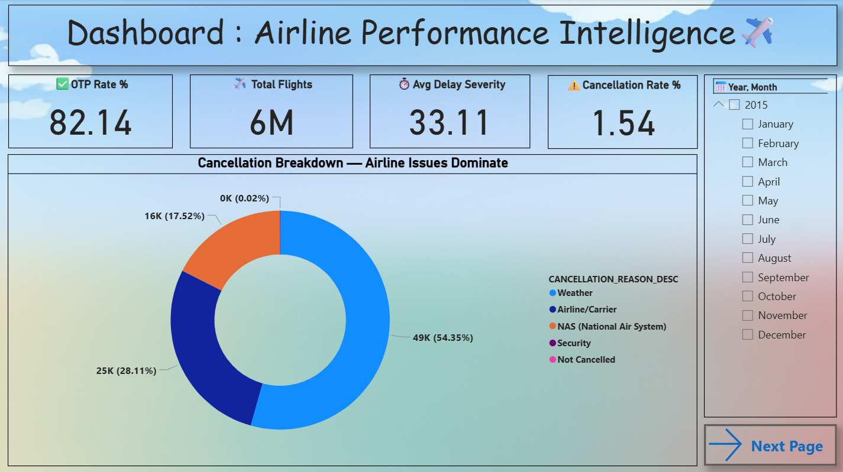






2. Overall Performance Snapshot
1
2
3
✈️ Overall OTP Rate
⏱️ Avg Delay Severity
❌ Cancellation Rate
82.14%
33.11 minutes (when delay occurs)
1.54%

Slide 6
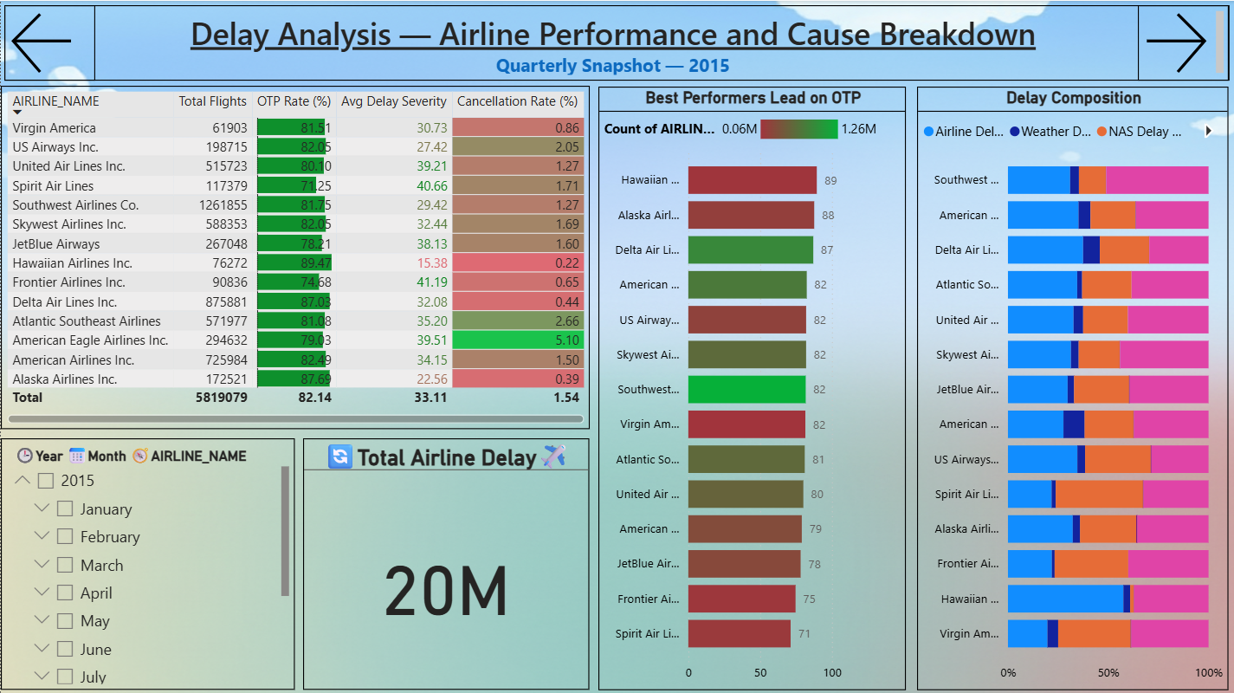
3. Insight 1 – The Control Problem
Finding
75% of system delays are controllable.

Slide 7








Insight
1
Late Aircraft Delay
40%
2
Airline Delay
35%
3
Weather Delay
only 10%

Slide 8
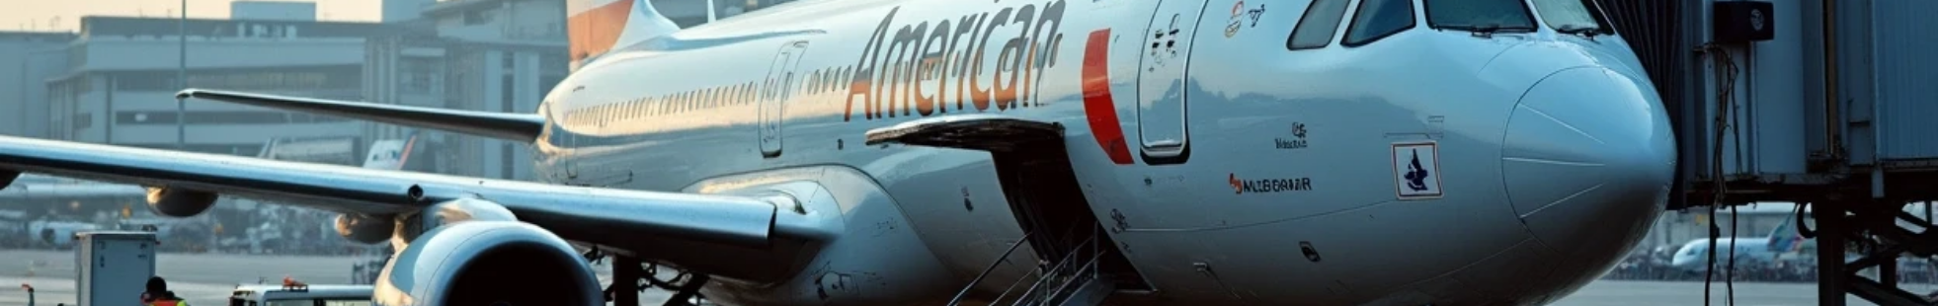
4. Deep Dive – American Airlines Case Study
Finding
American Airlines has the lowest OTP at 81.2%.
Insight
55% of AA’s delays are due to Late Aircraft — indicating turnaround inefficiency and poor maintenance readiness.

Slide 9
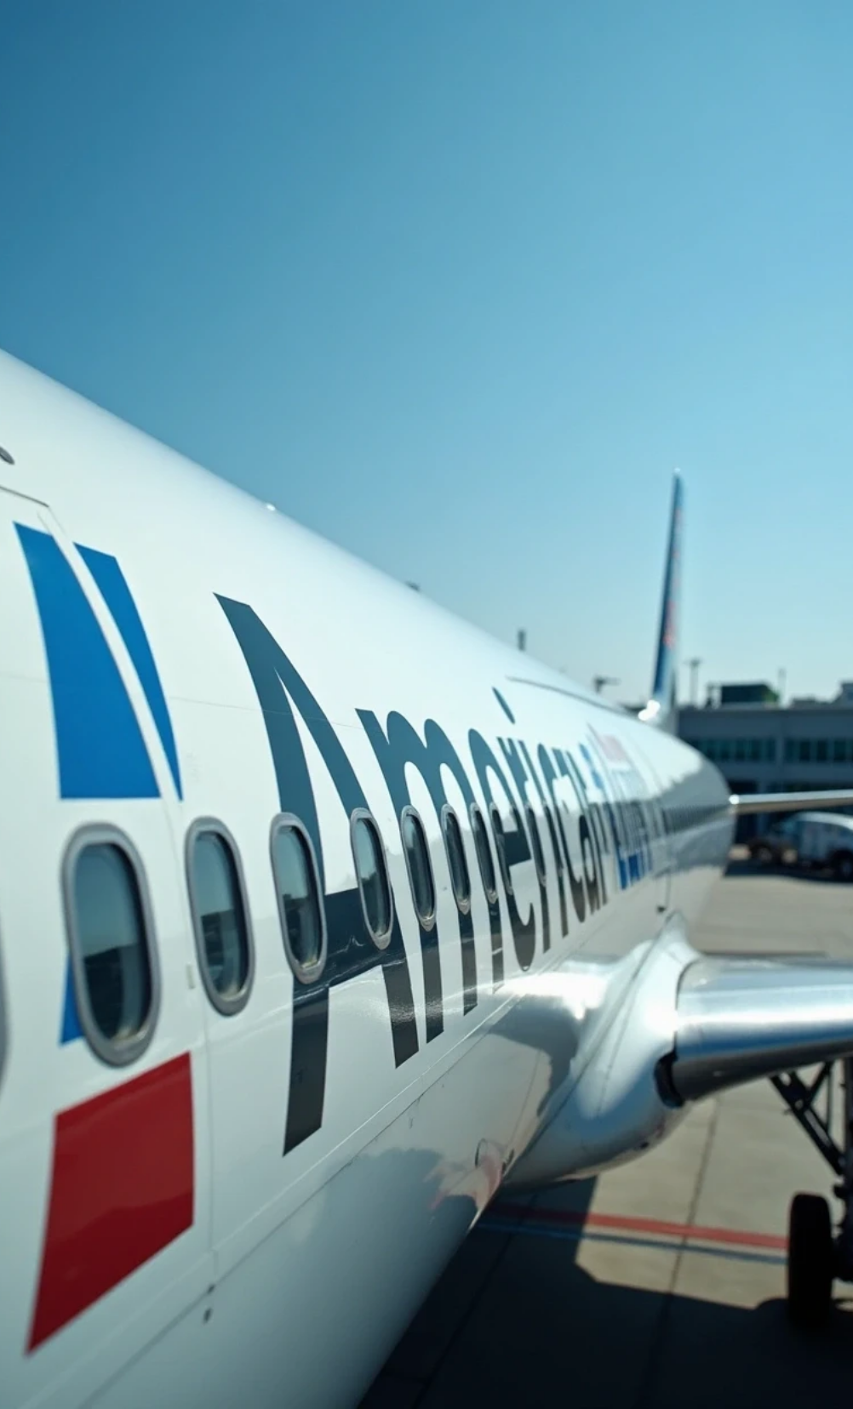
5. Recommendation 1 – The Carrier Fix
Stakeholder
Airline Carriers (AA, UA)
Recommendation
Implement Dynamic Turnaround Buffers
Action Plan:
• Introduce 30-minute buffer during peak months (July–August)
• Invest in predictive maintenance tools
Goal:
Eliminate the Late Aircraft Delay bottleneck.

Slide 10
5. Recommendation 1 – The Carrier Fix

Slide 11

Recommendation
Implement Dynamic Turnaround Buffers.

Slide 12




Action Plan
1
Introduce a 30-minute buffer during peak months (July–August).
2
Invest in predictive maintenance tools.

Slide 13
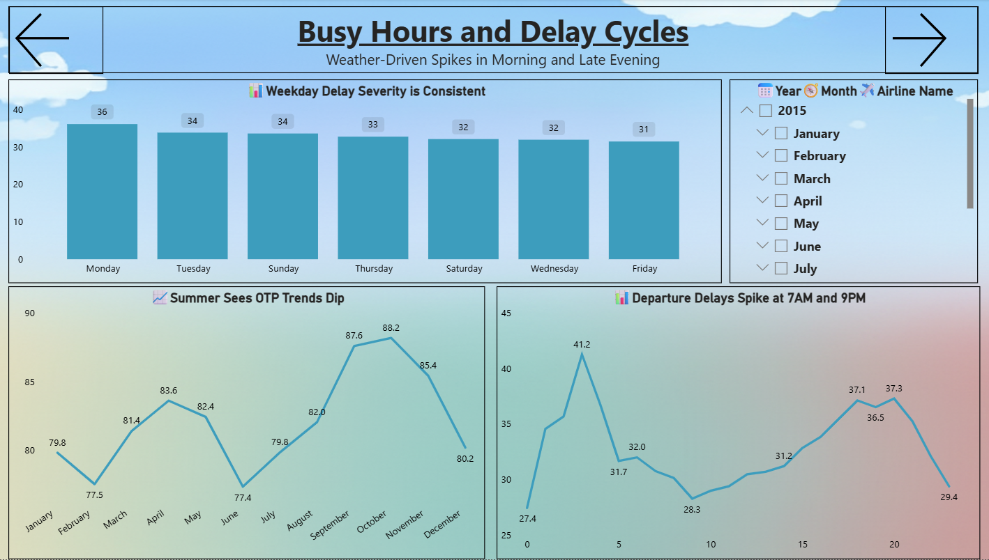
6. Insight 2 – Infrastructure Bottleneck
Finding
Severe delays (peaking at 70 mins) occur at EWR and ORD, specifically between 6:00 PM and 9:00 PM, driven by NAS (Air Traffic) Delays.
Insight
This is a fixed physical capacity limit (slot saturation) that requires central authority intervention.

Slide 14

7. Recommendation 2 – The Airport Fix
Stakeholder
Airport Authorities (EWR/ORD) & ATC

Slide 15

Recommendation
Optimize Evening Capacity via Slot Smoothing.

Slide 16




Action Plan
1
Stagger departure windows for regional carriers.
2
Collaborate with ATC to reduce congestion.

Slide 17



8. Conclusion & Strategic Outlook
Summary
• 75% of delays are controllable.
• Internal fixes (turnaround, scheduling) offer the highest ROI.
• Dashboard enables real-time monitoring and accountability.
Next Steps
• Expand analysis to 2023–2024.
• Pilot turnaround buffer strategy with AA.
• Share dashboard with airport ops teams.

Slide 18

Thank You

